Slide 1
Insertion of Fragments of DNA: Gene Disruption and Replacement

Slide 3
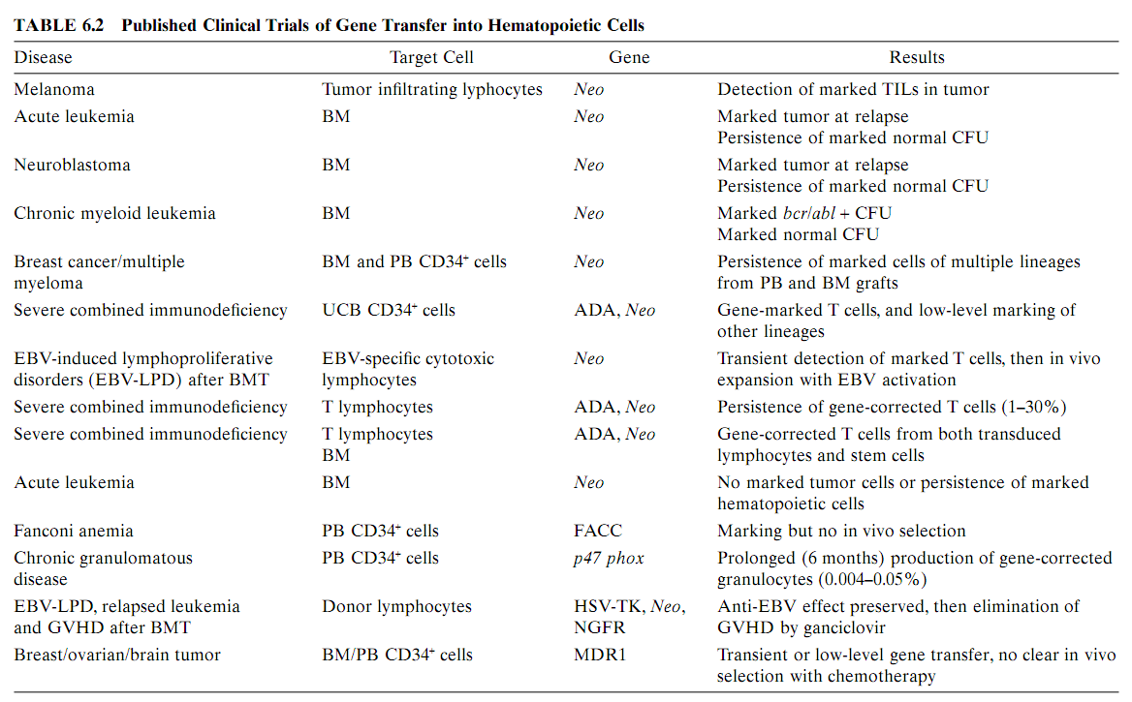

Slide 4
Gene transfer in murine system
Several different combinations of growth factors have been successfully used for supporting gene transfer into murine stem cells.
Combination of interleukin 3 (IL-3), interleukin 6 (IL-6), and stem cell factor (SCF). Inclusion of recently discovered early acting growth factors such as ﬂt-3 ligand and megakaryocyte growth and development factor (MGDF)/thrombopoietin (TPO) have augmented the level of genetically modiﬁed cells.
Treatment of animals with 5-ﬂuorouracil before marrow harvest to stimulate cycling of primitive cells,
The co-culture of target cells directly on a layer of retroviral producer cells or other stromal support,
The use of high titer (greater than 10⁵viral particles per ml) vector and
Co-localization of vector and target cells using ﬁbronectin-coated dishes.

Slide 5
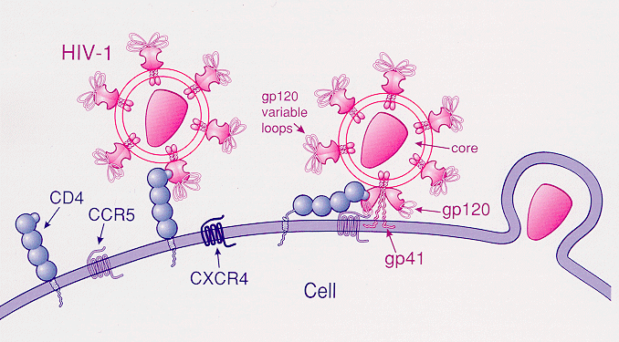
The T cell membrane (shown as the purple, semicircle double line) allows entry of HIV (in pink) into the cell through multiple cell receptors anchored on the membrane, including CCR5.

Slide 6
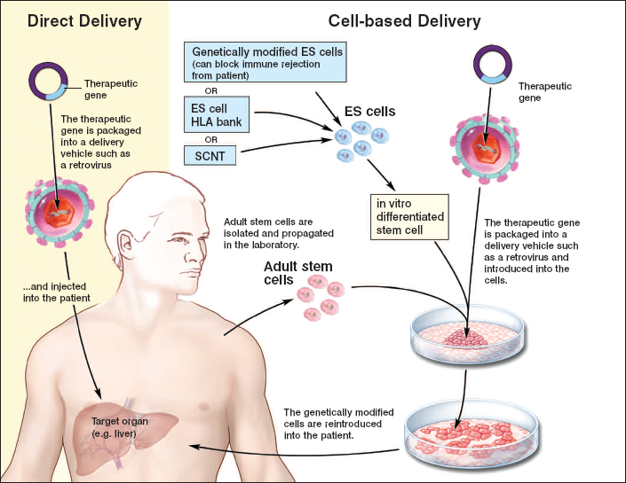
Use of Genetically Modified Stem Cells in Experimental Gene Therapies

